Slide 1
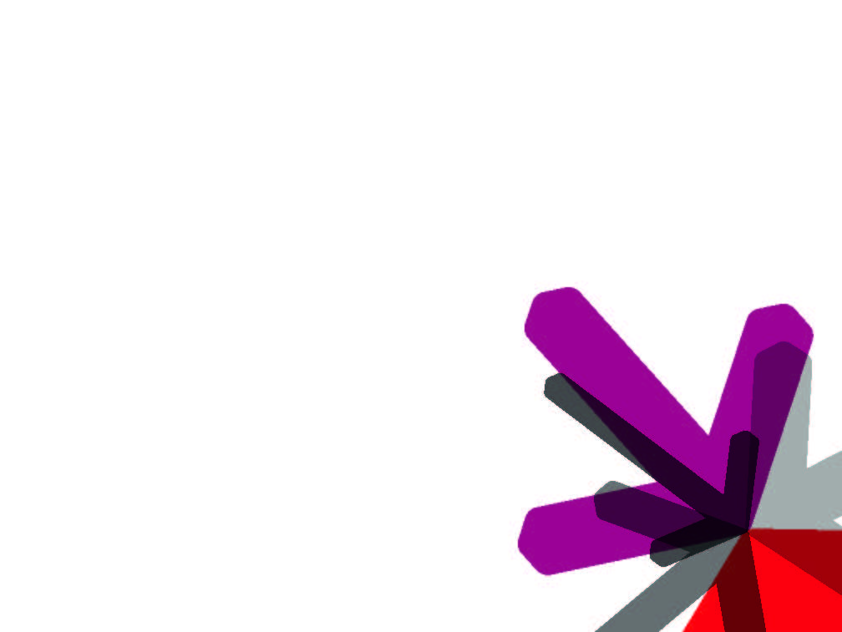
SERC – CADL
Indian Institute of Science
Bangalore, India
TWITTER STORM
Real Time, Fault Tolerant Distributed Framework
Created : 25th May, 2013
SONAL RAJ
National Institute of Technology,
Jamshedpur, India

Slide 2
Background
Created by Nathan Marz @ BackType/Twitter
Analyze tweets, links, users on Twitter
Opensourced at Sep 2011
Eclipse Public License 1.0
Storm 0.5.2
16k java and 7k Clojure LOC
Current stable release 0.8.2
0.9.0 major core improvement

Slide 3
Background
Active user group
https://groups.google.com/group/storm-user
https://github.com/nathanmarz/storm
Most watched java repo at GitHub (>4k watcher)
Used by over 30 companies
Twitter, Groupon, Alibaba, GumGum, ..

Slide 4
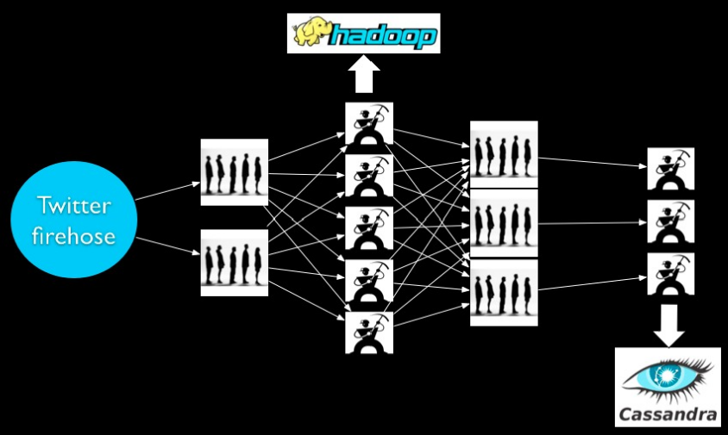
What led to storm . .

Slide 5
Problems . . .
Scale is painful
Poor fault-tolerance
Hadoop is stateful
Coding is tedious
Batch processing
Long latency
no realtime

Slide 6
Storm . . .Problems Solved !!
Scalable and robust
No persistent layer
Guarantees no data loss
Fault-tolerant
Programming language agnostic
Use case
Stream processing
Distributed RPC
Continues computation

Slide 7
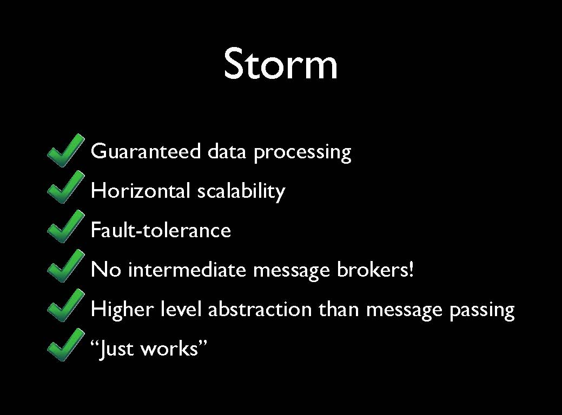
STORM FEATURES

Slide 8

Storm’s edge over hadoop
HADOOP
STORM
Batch processing
Jobs runs to completion
JobTracker is SPOF*
Stateful nodes
Scalable
Guarantees no data loss
Open source
Real-time processing
Topologies run forever
No single point of failure
Stateless nodes
Scalable
Guarantees no data loss
Open source
* Hadoop 0.21 added some checkpointing
SPOF: Single Point Of Failure

Slide 9

Streaming
Computation
^{Streaming}
^{Computation}
^{Streaming}
^{Computation}

Slide 10

Paradigm of stream computation
Queues / Workers

Slide 11


General method
Messages
Queue

Slide 12


general method
Message routing can be complex
Messages
Queue

Slide 13
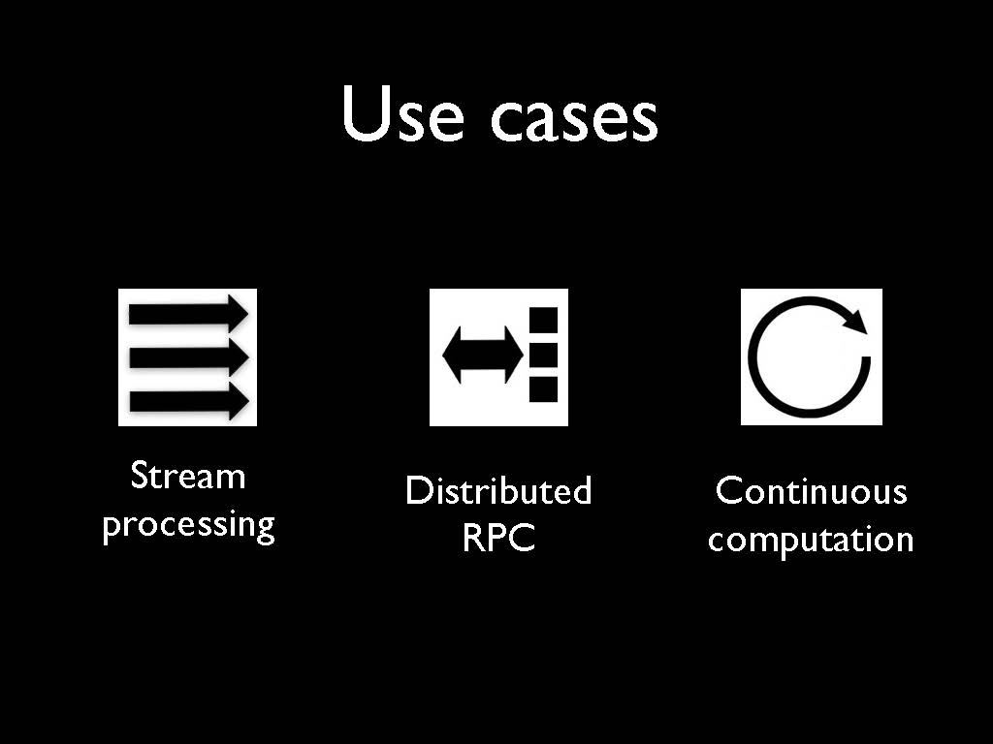
storm use cases

Slide 14
COMPONENTS
Nimbus daemon is comparable to Hadoop JobTracker. It is the master
Supervisor daemon spawns workers, it is comparable to Hadoop TaskTracker
Worker is spawned by supervisor, one per port defined in storm.yaml configuration
Task is run as a thread in workers
Zookeeper is a distributed system, used to store metadata. Nimbus and Supervisor daemons are fail-fast and stateless. All states is kept in Zookeeper.
Notice all communication between Nimbus and Supervisors are done through Zookeeper
On a cluster with 2k+1 zookeeper nodes, the system can recover when maximally k nodes fails.

Slide 15
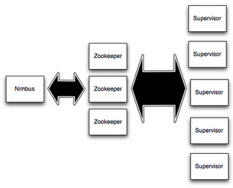
STORM ARchitecture

Slide 16
Storm architecture
Master Node ( Similar to Hadoop Job-Tracker )

Slide 17
storm architecture
Used for Cluster Co-ordination

Slide 18
storm architecture
Runs Worker Nodes / Processes

Slide 19
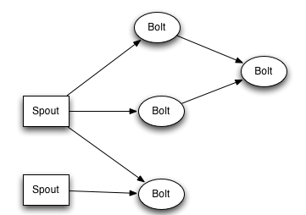
CONCEPTS
Streams
Topology
A spout
A bolt
An edge represents a grouping

Slide 20
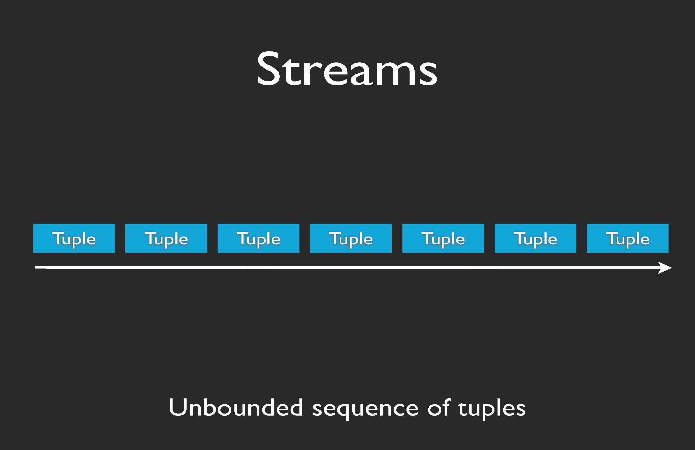
streams

Slide 21
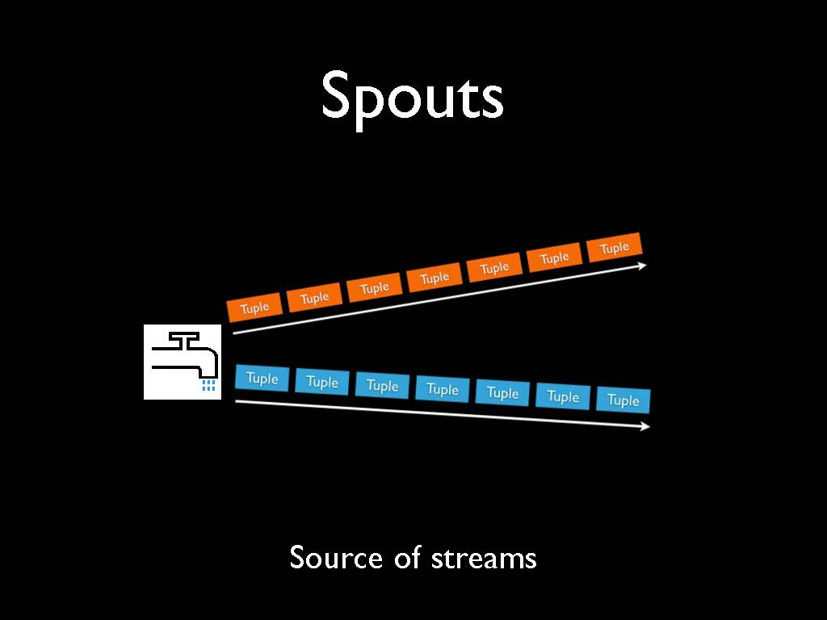
spouts
Example
Read from logs, API calls, event data, queues, …

Slide 22
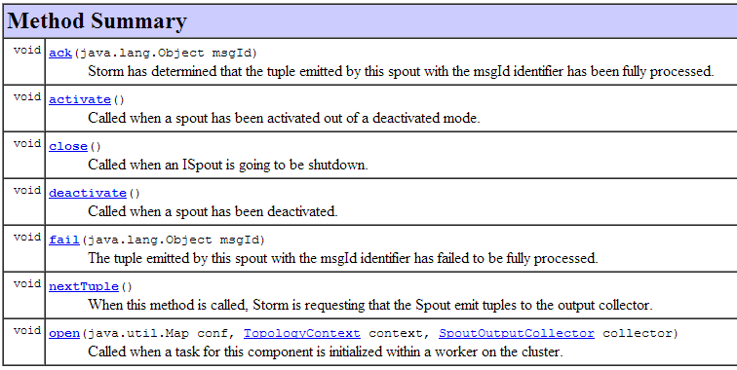
SPOUTS
Interface ISpout
Notes:
The Base* classes provide default implementations for commonly unused methods of the corresponding interfaces. It's recommended that you implement your spouts and bolts by extending the appropriate Base* class. The first method called in a spout is always public void open(….).

Slide 23
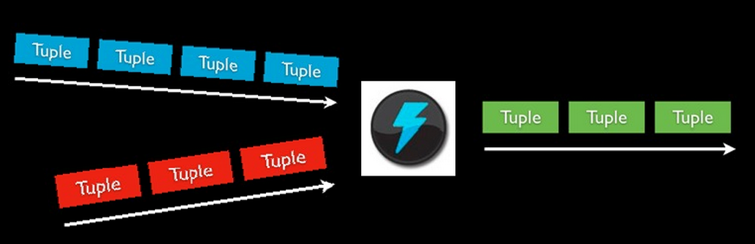
Bolts
Bolts
Processes input streams and produces new streams
Example
Stream Joins, DBs, APIs, Filters, Aggregation, …

Slide 24
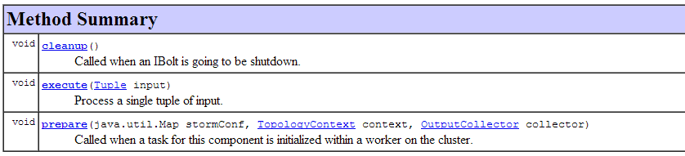
BOLTS
Interface Ibolt

Slide 25
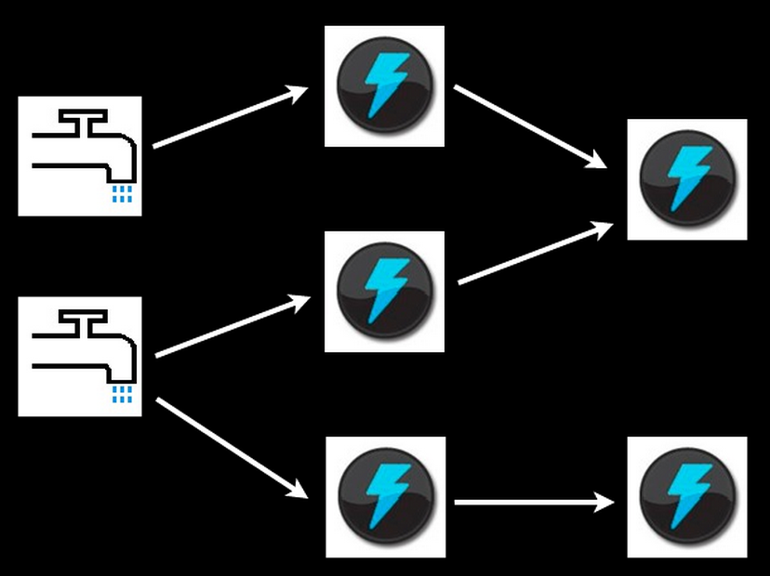
TOPOLOGY
Topology
is a graph where each node is a spout or bolt, and the edges indicate which bolts are subscribing to which streams.

Slide 26
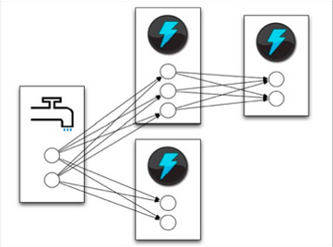
TASKS
Parallelism is implemented using multiples instances of each spout and bolt for simultaneous similar tasks. Spouts and bolts execute as many tasks across the cluster.
Managed by the supervisor daemon

Slide 27
Stream groupings
When a tuple is emitted, which task does it go to?

Slide 28
Stream grouping
Shuffle grouping: pick a random task
Fields grouping: consistent hashing on a
subset of tuple fields
All grouping: send to all tasks
Global grouping: pick task with lowest id

Slide 29
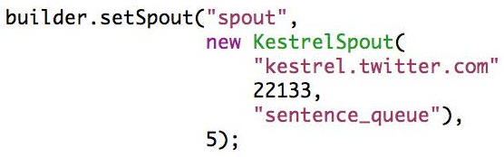
example : streaming word count
TopologyBuilder is used to construct topologies in Java.
Define a Spout in the Topology with parallelism of 5 tasks.

Slide 30
abstraction : DRPC
Consumer decides what data it receives and how it gets grouped
Split Sentences into words with parallelism of 8 tasks.
Create a word count stream

Slide 31
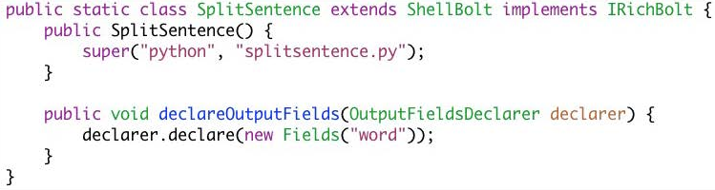
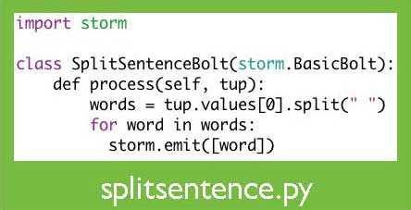
abstraction : DRPC

Slide 32
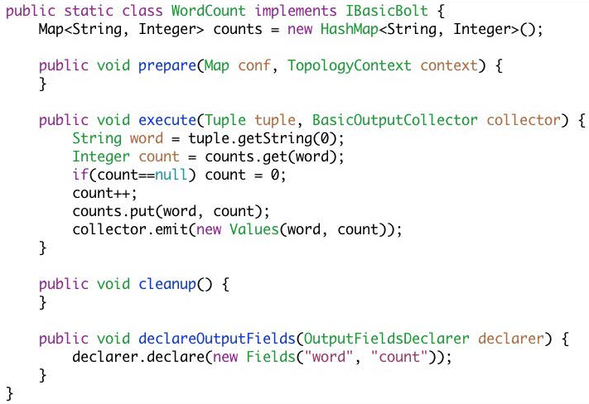
Inside a bolt . .

Slide 33
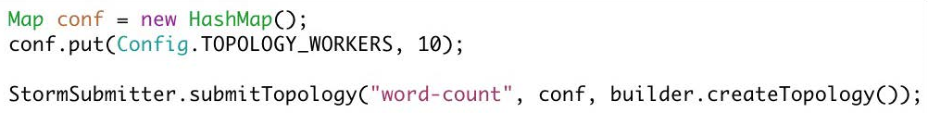
abstraction : DRPC
Submitting Topologies to the cluster

Slide 34
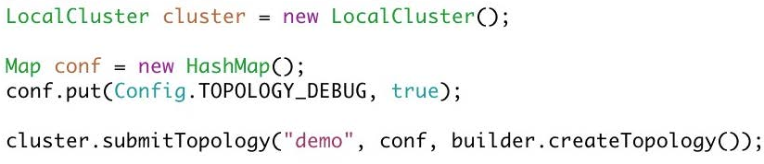
abstraction : DRPC
Running the Topology in Local Mode

Slide 35
Fault-Tolerance
Zookeeper stores metadata in a very robust way
Nimbus and Supervisor are stateless and only need metadata from ZK to work/restart
When a node dies
The tasks will time out and be reassigned to other workers by Nimbus.
When a worker dies
The supervisor will restart the worker.
Nimbus will reassign worker to another supervisor, if no heartbeats are sent.
If not possible (no free ports), then tasks will be run on other workers in topology. If more capacity is added to the cluster later, STORM will automatically initialize a new worker and spread out the tasks.
When nimbus or supervisor dies
Workers will continue to run
Workers cannot be reassigned without Nimbus
Nimbus and Supervisor should be run using a process monitoring tool, to restarts them automatically if they fail.

Slide 36
AT LEAST ONCE Processing
STORM guarantees at-least-once processing of tuples.
Message id, gets assigned to a tuple when emitting from spout or bolt. Is 64 bits long
Tree of tuples is the tuples generated (directly and indirectly) from a spout tuple.
Ack is called on spout, when tree of tuples for spout tuple is fully processed.
Fail is called on spout, if one of the tuples in the tree of tuples fails or the tree of tuples is not fully processed within a specified timeout (default is 30 seconds).
It is possible to specify the message id, when emitting a tuple. This might be useful for replaying tuples from a queue.
Ack/fail method called when tree of tuples have been fully processed or failed / timed-out

Slide 37
AT Least once processing
Anchoring is used to copy the spout tuple message id(s) to the new tuples generated. In this way, every tuple knows the message id(s) of all spout tuples.
Multi-anchoring is when multiple tuples are anchored. If the tuple tree fails, then multiple spout tuples will be replayed. Useful for doing streaming joins and more.
Ack called from a bolt, indicates the tuple has been processed as intented
Fail called from a bolt, replays the spout tuple(s)
Every tuple must be acked/failed or the task will run out of memory at some point.
_collector.emit(tuple, new Values(word)); ← Uses anchoring
_collector.emit(new Values(word)); ← Does NOT use anchoring

Slide 38
exactly once processing
Transactional topologies (TT) is an abstraction built on STORM primitives.
TT guarantees exactly-once-processing of tuples.
Acking is optimized in TT, no need to do anchoring or acking manually.
Bolts execute as new instances per attempt of processing a batch
Example
All grouping
Bolt
Task: 2
1. A spout tuple is emitted to task 2 and 3
2. Worker responsible for task 3 fails
3. Supervisor restarts worker
4. Spout tuple is replayed and emitted to task
2 and 3
5. Task 2 and 3 initiate new bolts because of new
attempt
Now there is no problem
Spout
Task: 1
Bolt
Task: 3

Slide 39
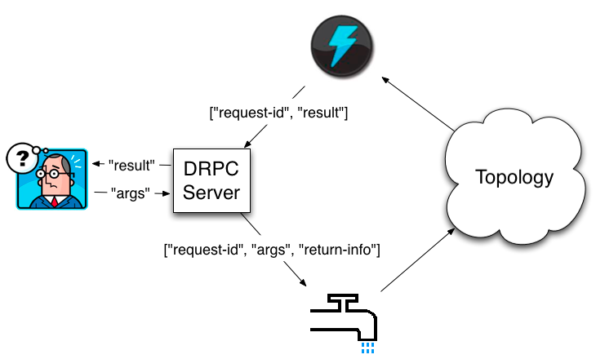
abstraction : DRPC
Distributed RPC Architecture

Slide 40
WHY DRPC ?
Before Distributed RPC, time-sensitive queries relied on a pre-computed index
Storm Does away with the indexing !!

Slide 41
abstraction : DRPC example
Calculating the “Reach” of URL on the fly (in real time ! )
Written by Nathan Marz to implement storm !
Real World Application of Storm , open source, available at http://github.com/nathanmarz/storm
Reach is the number of unique people exposed to a URL (tweet) on twitter at any given time.

Slide 42
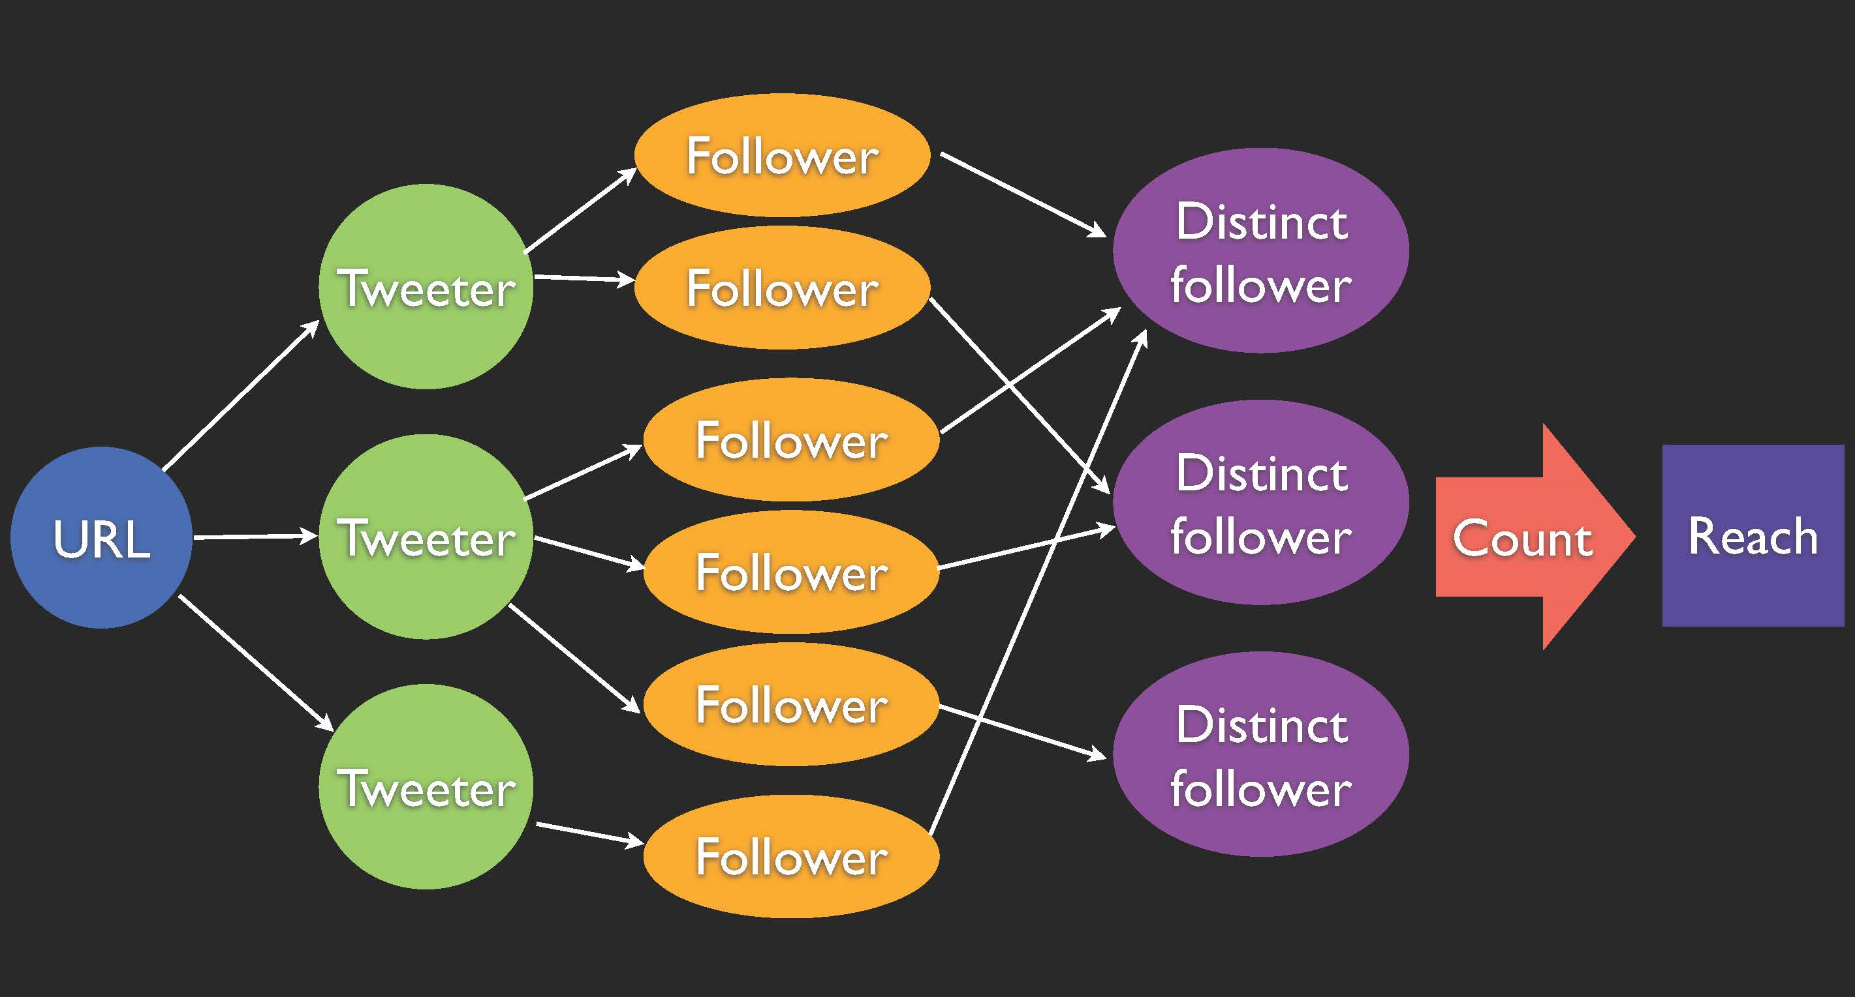
abstraction : DRPC >> computing reach

Slide 43
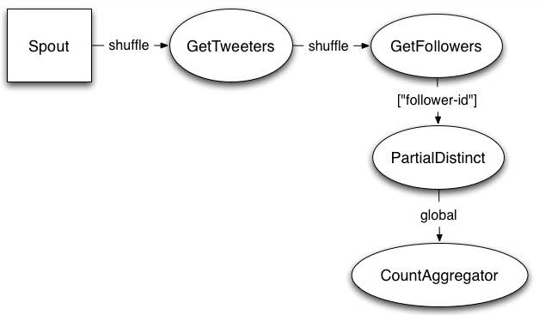
abstraction : DRPC >> Reach topology

Slide 44
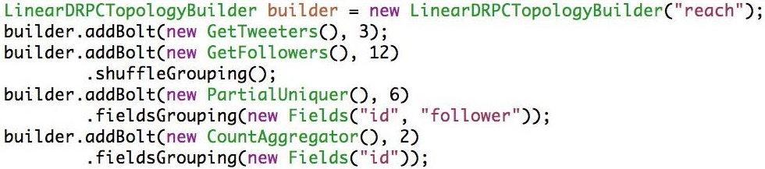
abstraction : DRPC >> Reach topology
Create the Topology for the DRPC Implementation of Reach Computation

Slide 45
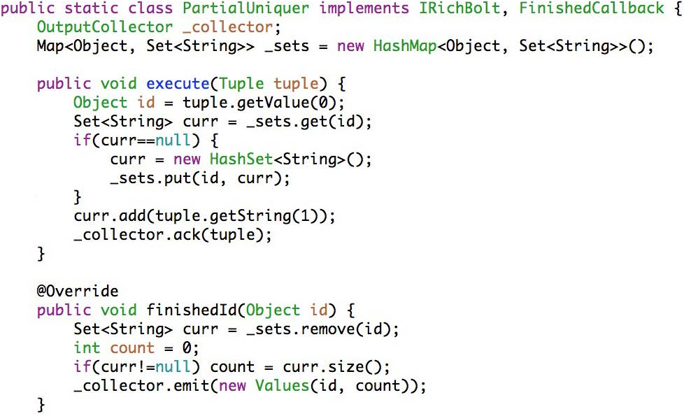
abstraction : DRPC

Slide 46
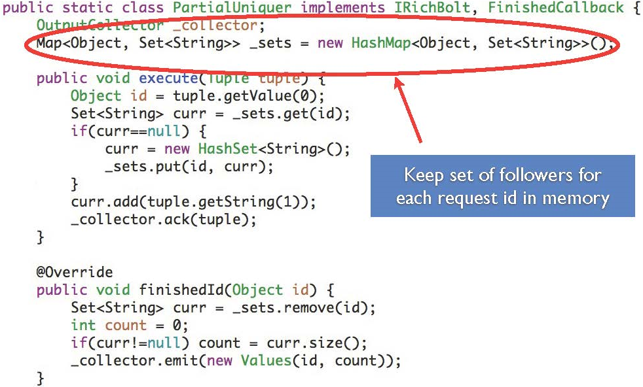
abstraction : DRPC

Slide 47
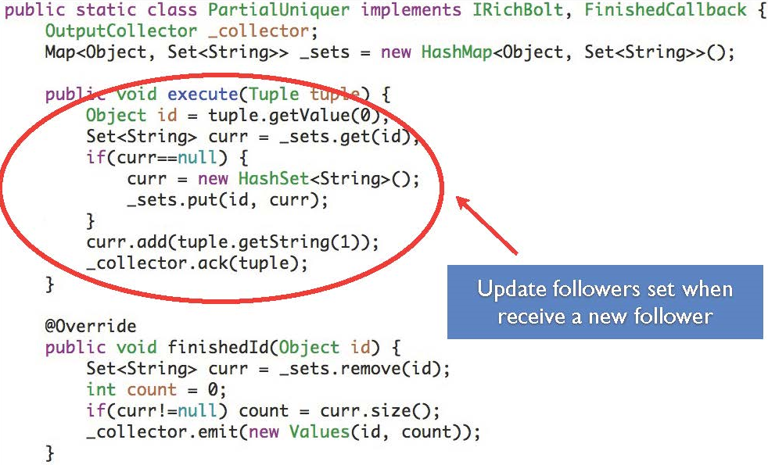
abstraction : DRPC

Slide 48
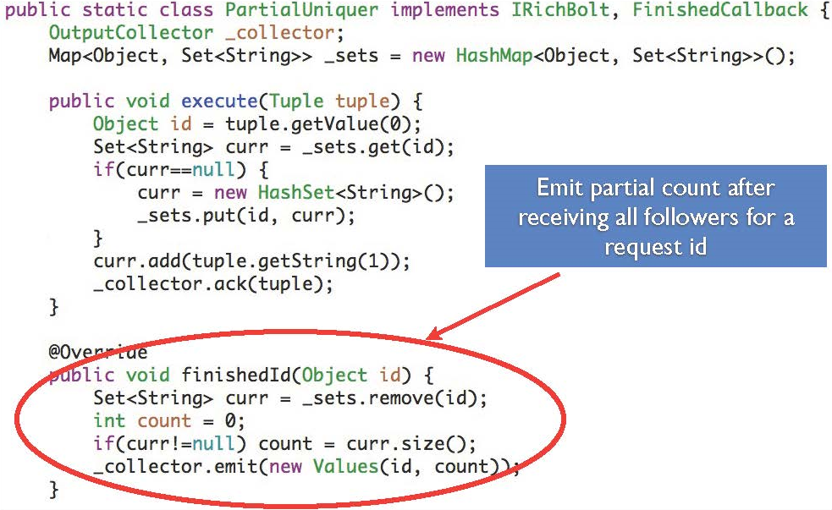
abstraction : DRPC

Slide 49
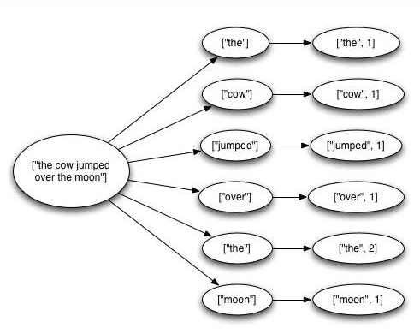
guaranteeing message processing
Tuple Tree

Slide 50
Guaranteeing message processing
A spout tuple is not fully processed until all tuples in the tree have been completed.
If the tuple tree is not completed within a specified timeout, the spout tuple is replayed
Use of an inherent tool called the Reliability API

Slide 51
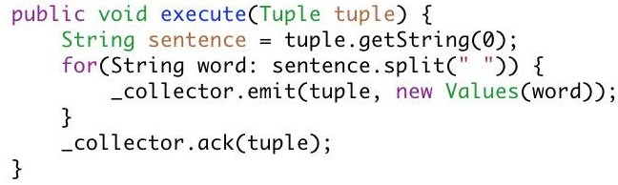
Guaranteeing message processing
“ Anchoring “ creates a new edge in the tuple tree
Marks a single node in the tree as complete
Storm tracks tuple trees for you in an extremely efficient way

Slide 52
Running a storm application
Local Mode
Runs on a single JVM
Used for development testing and debugging
Remote Mode
Submit our processes to Storm Cluster which has many processes running on different machines.
Doesn’t show debugging info, hence it is considered Production Mode.

Slide 53
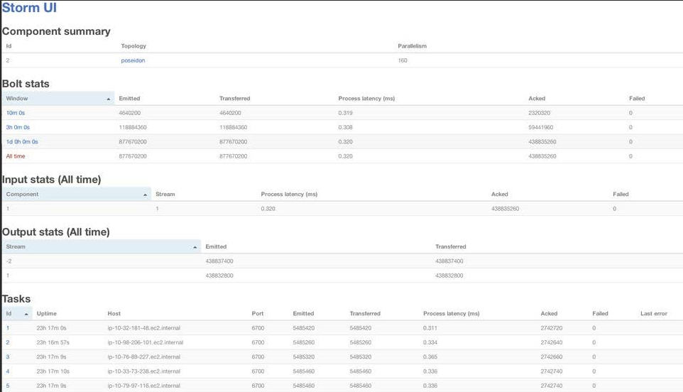
storm ui

Slide 54
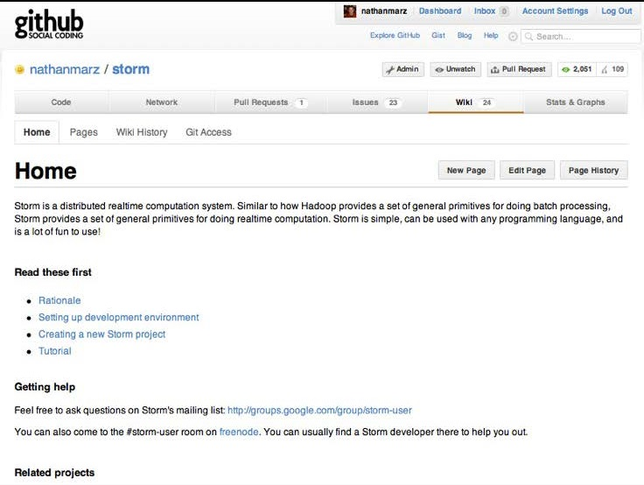
Documentation

Slide 55

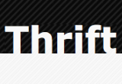


STORM LIBRARIES . .
STORM uses a lot of libraries. The most prominent are
Clojure a new lisp programming language. Crash-course follows
Jetty an embedded webserver. Used to host the UI of Nimbus.
Kryo a fast serializer, used when sending tuples
Thrift a framework to build services. Nimbus is a thrift daemon
ZeroMQ a very fast transportation layer
Zookeeper a distributed system for storing metadata

Slide 56
References
Twitter Storm
Mathan Marz
http://www.storm-project.org
Storm
nathanmarz@github
http://www.github.com/nathanmarz/storm
Realtime Analytics with Storm and Hadoop
Hadoop_Summit

Slide 57
Thank You

